Slide 1
File Sharing feature design

Slide 2
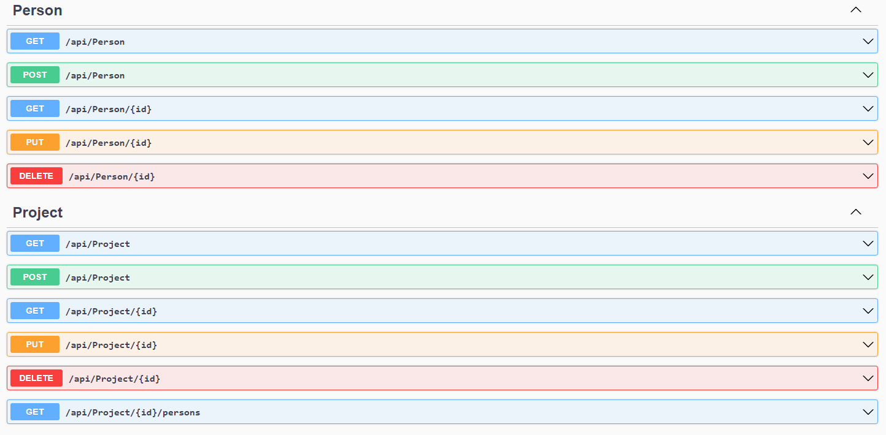
API endpoints

Slide 3
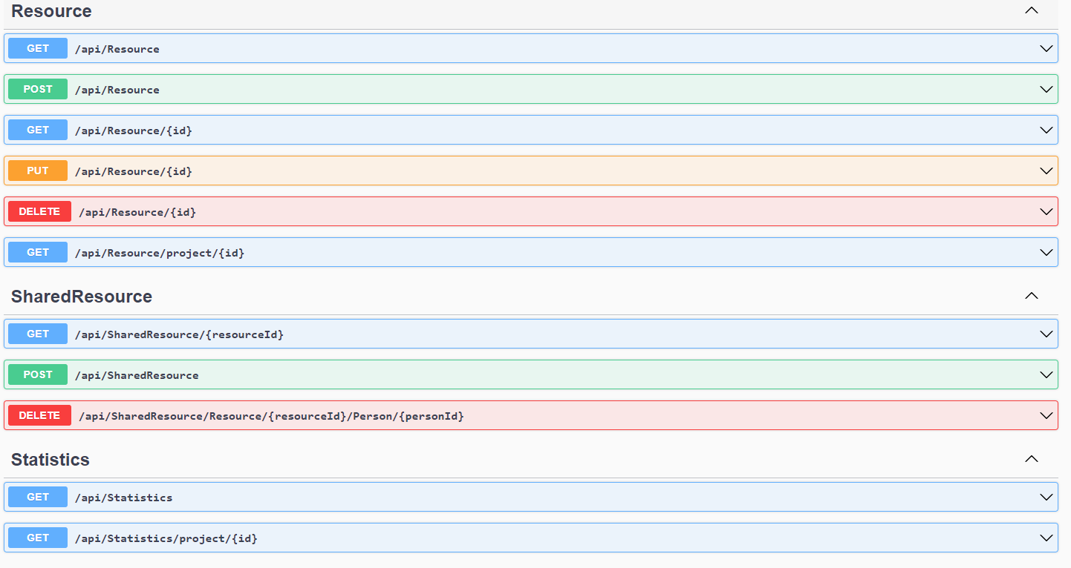
API endpoints contd…

Slide 4
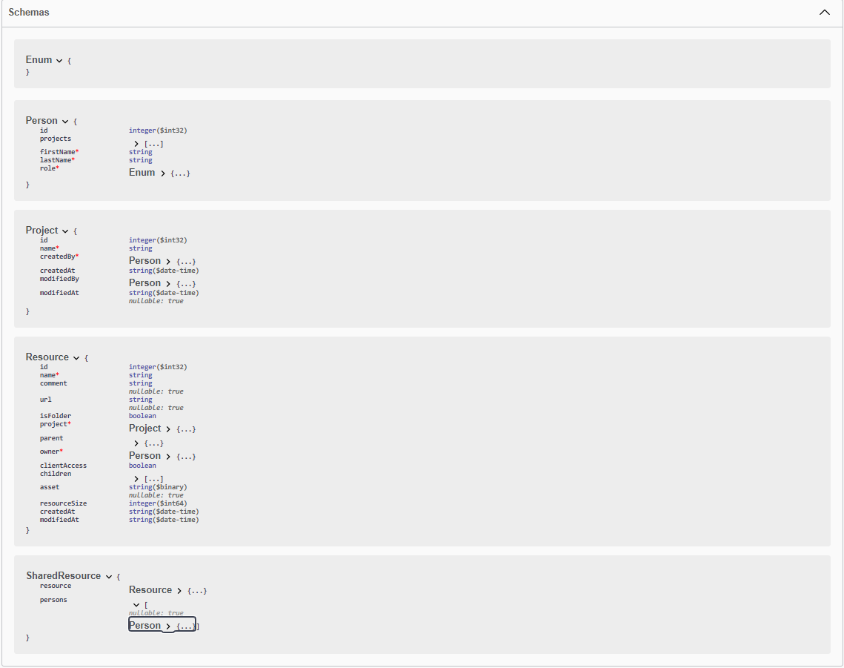
Schemas

Slide 5
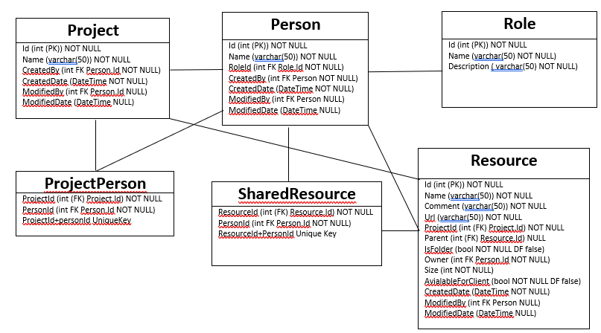
DB Design

Slide 6
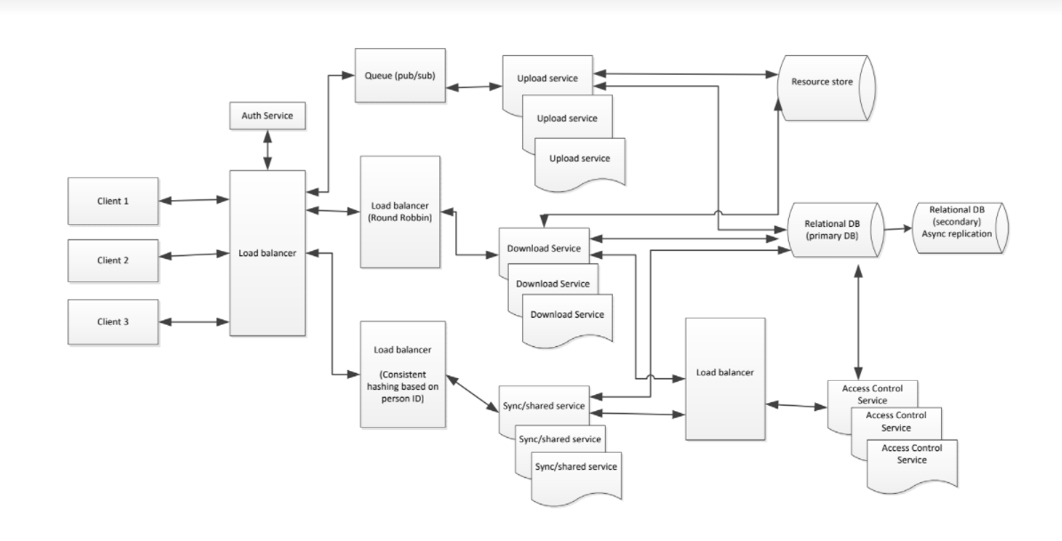
System Design

Slide 7
Task List
Dev/QA/Staging task list:
Infrastructure:
Build Application server instances for Upload/Download/Sync & sharing/ACL Services.
CI/CD pipelines Upload/Download/Sync & sharing/ACL Services to be published to their respective server instances.
Assuming the org is already utilizing AWS for cloud solutions, we can use Amazon S3 for storing files/videos uploaded by the users. Need to create storage accounts for each environment.
Retrieve secure keys/tokens for each storage account in each environment and provide them to engineers.
Development:
Create separate projects for Upload/Download/Sync & sharing/ACL Services
Create GIT/source control repositories for each project
DB changes on Dev DB.
Create scripts to copy data from old tables to new tables.
Add Amazon S3 storage account access tokens to project config files.
Upload Service:
SPIKE: Research async upload API from Amazon S3.
Identify API endpoints for each service.
Create models that represent data for each endpoint.
Identify response structure and standardize responses with existing practices.

Slide 8
Task List Contd..
Download Service:
SPIKE: Research async download API from Amazon S3.
Identify API endpoints for each service.
Create models that represent data for each endpoint.
Identify response structure and standardize responses with existing practices.
Sync service:
Create long polling mechanism to respond to the client when there is a change in file share structure for the client.
Identify API endpoints for each service.
Create models that represent data for each endpoint.
Identify response structure and standardize responses with existing practices.
Share service:
Backend changes required to handle the file share mechanism and the DB queries required to Add a shared file to a user or remove a shared file.
Enable serve caching for the user’s resource structure.
Identify API endpoints for each service.
Create models that represent data for each endpoint.
Identify response structure and standardize responses with existing practices.
Access Control service:
Define services that checks if a user requesting a resource has access to it.
Identify API endpoints for each service.
Create models that represent data for each endpoint.
Identify response structure and standardize responses with existing practices.

Slide 9
Task List Contd..
Prod task list:
Infrastructure:
Build Application server instances (multiple) for Upload/Download/Sync & sharing/ACL Services.
CI/CD pipelines Upload/Download/Sync & sharing/ACL Services to be published to their respective server instances.
Create prod storage account for Amazon S3.
Build out components as laid out in the systems design architecture diagram. (This needs to start much in advance given the complexity of the implementation)
Dev:
DB scripts

Slide 10
Rollout plan
Sprint 0 (Environment setup)
Dev Environment
Dev Storage Account
DB
Projects
Git repo
Sprint 1
QA/Staging Environment
ACL (backend)
Resource Sharing services(backend)
Upload Service (spike)
Download Service (spike)
Sync service (spike)
Sprint 2
Prod Environment
API response structure
ACL API
Shared Services API
Upload Services
Download Services
Sprint 3
Prod environment setup verification
Prod environment setup contd..
QA release – ACL services, Shared services.
Bug fixes
Upload API
Download API

Slide 11
Rollout plan contd..
Sprint 4
Prod environment verification
Prod Environment setup contd..
UAT release – Shared services
QA release – Upload services, Download services
QA Bug Fixes
UAT feedback/fixes
Sprint 5
Prod environment final verification and final changes if required.
UAT release – Upload services, Download services
QA Bug Fixes
UAT feedback/fixes
Prep for prod release (DB scripts, verify storage accounts etc..)
Prod Release
DB scripts
Prod validation

